Slide 1
Classifying Alzheimer’s Progression from MRIs using CNNs
By: Matthew Zhang

Slide 2
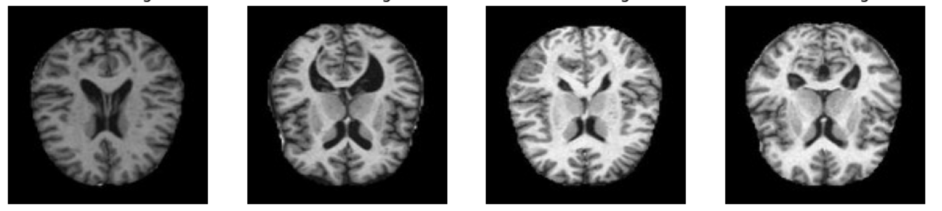
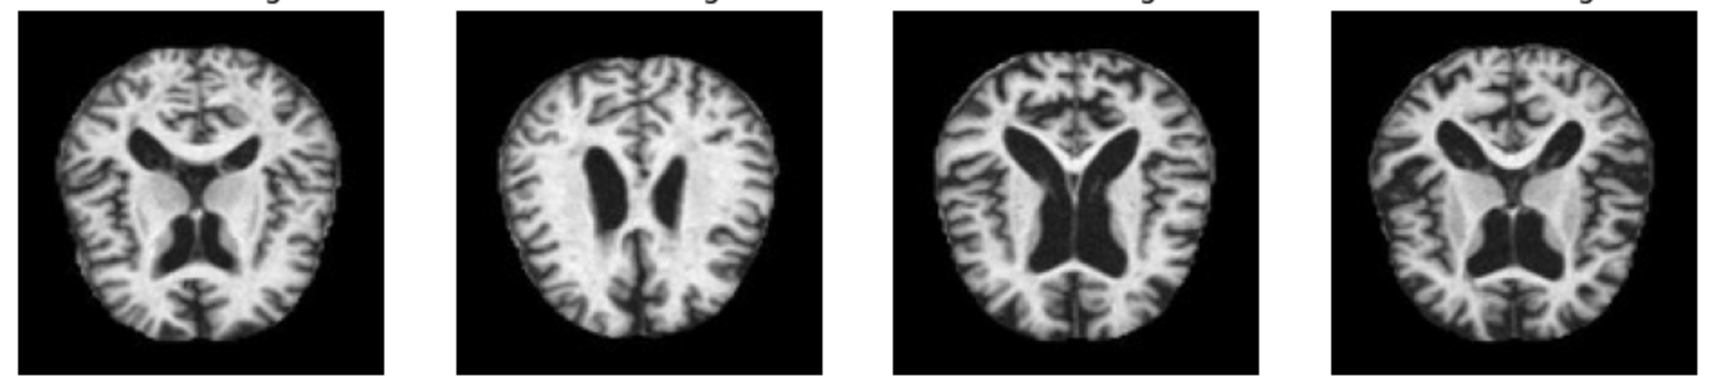
Quick Test
Moderately-Demented
Alzheimer-Free

Slide 3
The Core Issue
Goal: Give a label to MRI scans that represents Alzheimer’s progression (classification problem)
Differences in MRIs can be due to:
Sex
Age
Head Size
Normal Anatomical Variability
Ethnic and Genetic Variation
Many different factors in play, makes diagnosis very difficult
Need to determine level of progression
What is our solution:
MACHINE LEARNING MODELS!
Can be trained on large volumes of data to find patterns

Slide 4
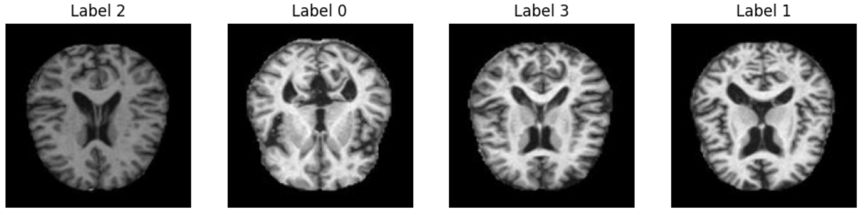
Dataset Investigation
0: Mildly Demented 1: Moderately Demented 2: Non-Demented 3: Very Mildly Demented
Determined by CDR (Clinical Dementia Rating)
0 = CDR(0)
1 = CDR(0.5)
2 = CDR(1)
3 = CDR(2)
CDR ranges from 0 - 3

Slide 5
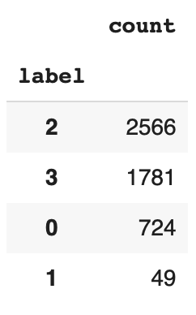
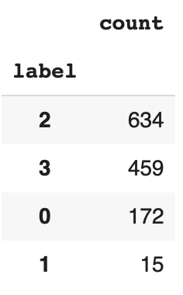
Dataset Size and Issues
From Hugging Face, created by Falah.G.Salieh, https://huggingface.co/datasets/Falah/Alzheimer_MRI
Training Set: 5120 MRIs, Testing Set: 1280 MRIs
Training Set
Testing Set
Very clear class imbalance (barely any moderately demented scans)
Very common problem with medical datasets
Want to use other metrics such as recall and precision

Slide 6
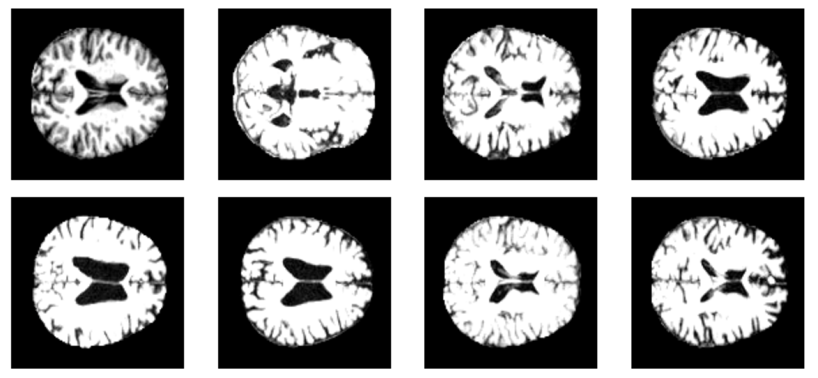
Data Preprocessing
Many scans overall are darker, need to normalize pixel values
Preprocessing Steps:
Resize all scans to 128 x 128 to shrink spatial dimensions
Normalize using transforms.Normalize(mean=[.1]*3, std=[0.4]*3)
Result:

Slide 7

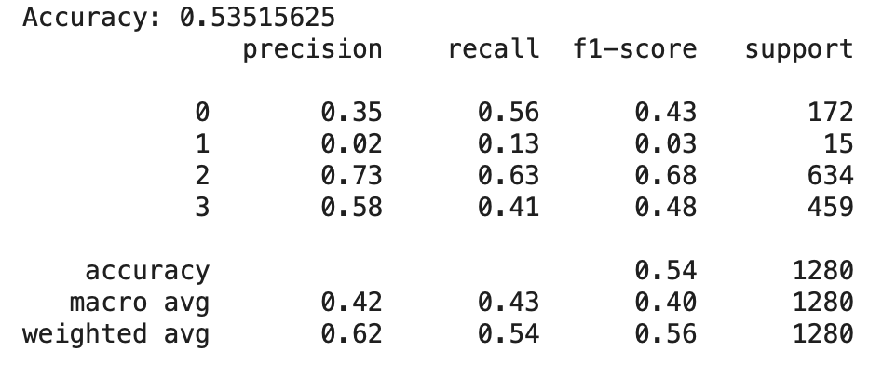
Model Selection
Looked at classification models such as LogisticRegression, why won’t they perform well?
No mechanism for storing spatial information
Input is a flattened vector
Simple linear model, cannot capture complex relationships
Performance of LogisticRegression after 20 epochs:

Slide 8
Model Selection continued…
What about a neural network?
Can capture more complex relationships than simple logistic regression, but…
Assigns parameters to individual pixels, makes it prone to overfitting and not very generalizable
Same issue with no spatial relationships captured
Solution:
Convolutional Neural Networks!
Performs convolutions that helps capture spatial features such as edges and texture/color
Compresses representation so it stores the components of the image that are the most helpful in classifying it.
Then, learned representation of image goes through a MLP (multilayer perceptron).

Slide 9
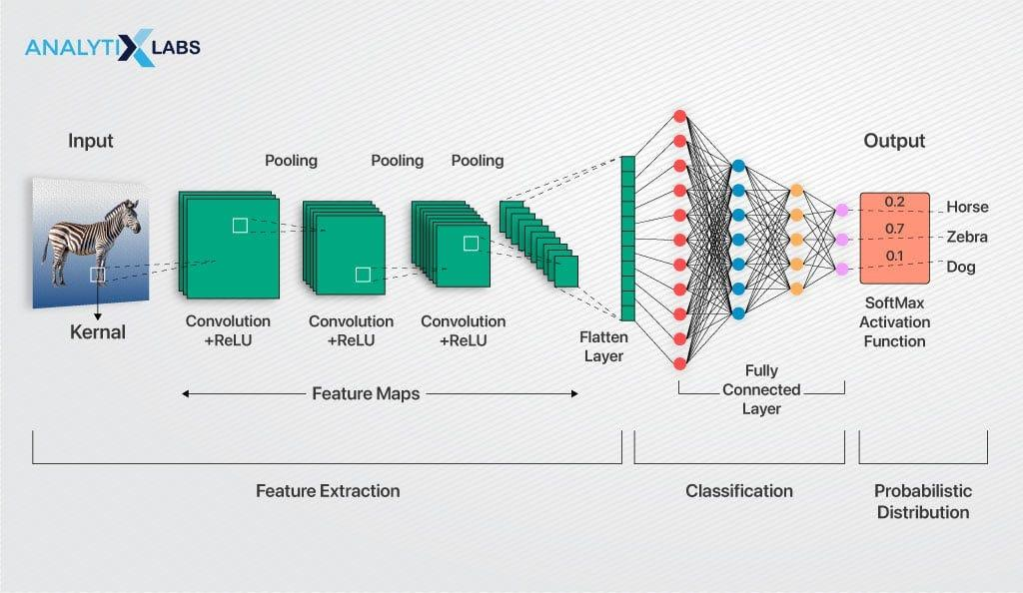
Overview of Convolutional Neural Network
First layer: Convolution Layers
Computes a dot product between regions of the image and filter matrix
Creates an activation map of the image so that the values are no longer the pixel values but values that act as indicators of the feature that layer is trying to find
The idea is that shallow layers extract simpler features and deeper layers can extract more complex, specific features.

Slide 10
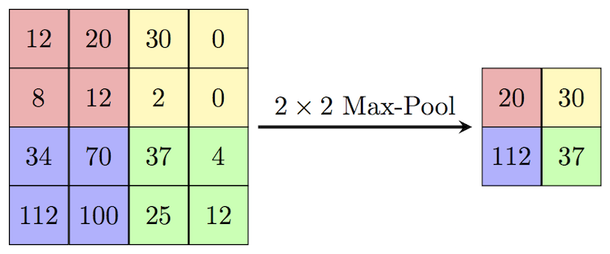
Convolutional Neural Networks continued…
Batch Normalization
Normalizes all values over a feature map
Prevents vanishing and exploding gradients (features either have a super large or super small effect on the output)
Max Pooling
Applies a filter to extract the highest value from a section of the activation map.
Idea is that it’ll extract the most important feature from the region
Applies further dimensionality reduction

Slide 11
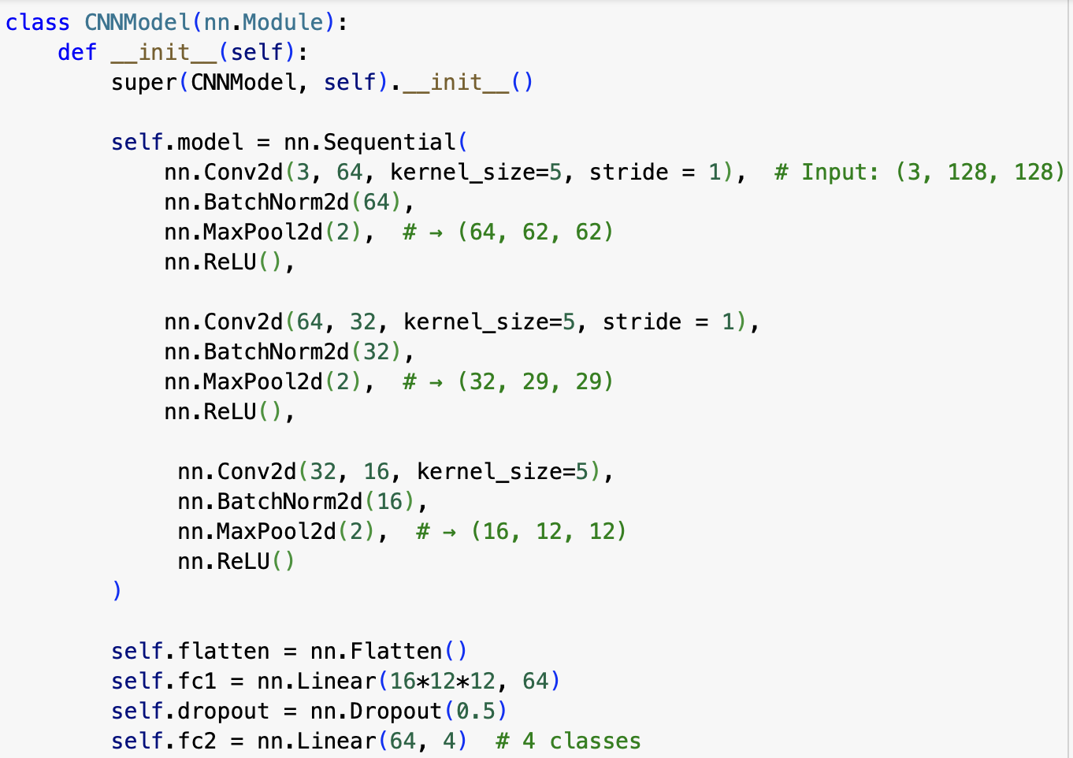
Model Architecture
First convolutional layer: Takes in 3 x 128 x 128 image
Applies 64 5x5 filters along the image to create 64 124 x 124 activation maps that are concatenated.
2 x 2 max pooling filter reduces the output of the layer to 64 x 62 x 62.
Eventual output of final convolutional layer is 16 x 12 x 12.

Slide 12
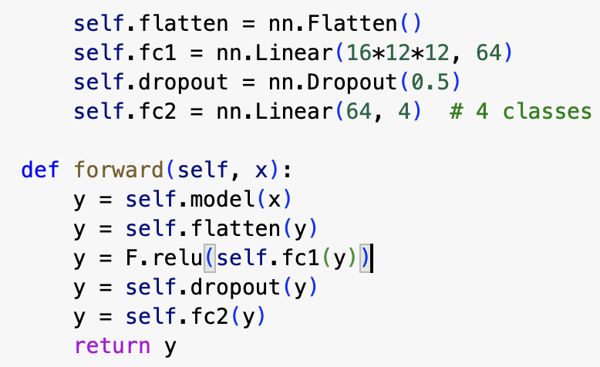
Forward Pass through MLP
Learned representation from convolution layers is flattened
The nn.Linear layers apply linear transformations to the input
Basically assigning the importance of the features learned through the convolutions in making it’s prediction
ReLU helps the model learn complex, nonlinear relationships between the features and model’s output.
Final output is a vector of scores for each class that represents the model’s prediction

Slide 13
Training Parameters and Performance
Loss function: Cross Entropy
Applies softmax (turns vector of scores into a probability distribution)
An assessment of how well the model predicted
Optimizer: Adam
How the model performs back propagation to adjust model parameters
Ex: Gradient Descent
Learning rate: 5 * 10^-4
HUZZAH 94% ACCURACY!
But what about recall? Precision? F1 Score?

Slide 14
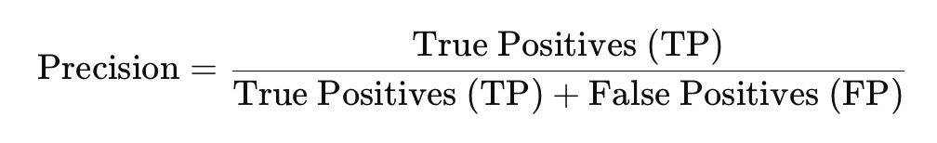
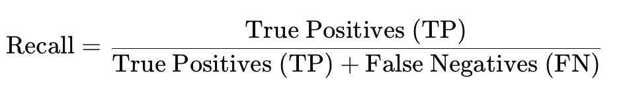
Why Recall and Precision are important
If you remember, only 50/5120 training examples were the moderately demented class.
Want high recall and precision for the non-demented class (class 2) and high recall for the moderately demented class (class 1)
Don’t want to misdiagnose a patient with Alzheimer’s when they don’t have it (recall)
Don’t want someone with Alzheimer’s to be diagnosed with not having it (precision)
Similarly, don’t want patient that has progressed significantly to be misdiagnosed.
RECALL FOR CLASS 1 ON THE MODEL WAS 0

Slide 15
Accounting for Class Imbalance
Solution: Class weights
Multiplies the loss associated with each class by a weight
Can put a higher penalty when the model doesn’t predict examples of the minority class correctly
Makes it so the model cares more about the minority class even though there are less examples
How do we calculate?
1/(frequency of samples in training set)
Less frequent classes get higher weights.
Weight Vector = [0.0026, 0.01, 0.0008, 0.001]

Slide 16
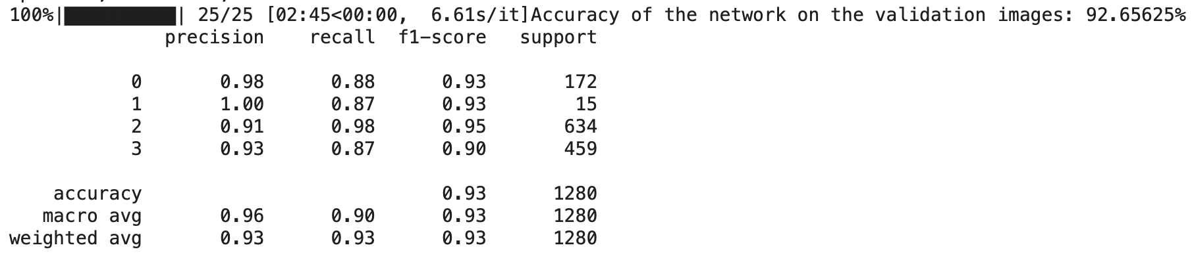
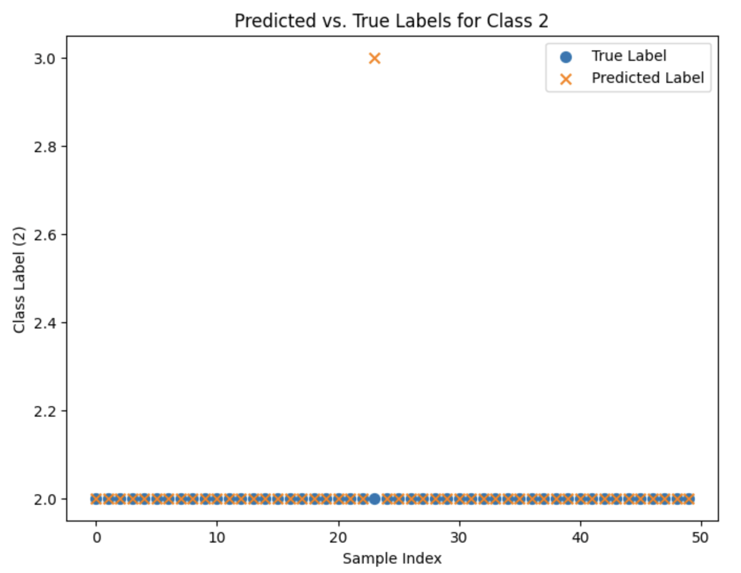
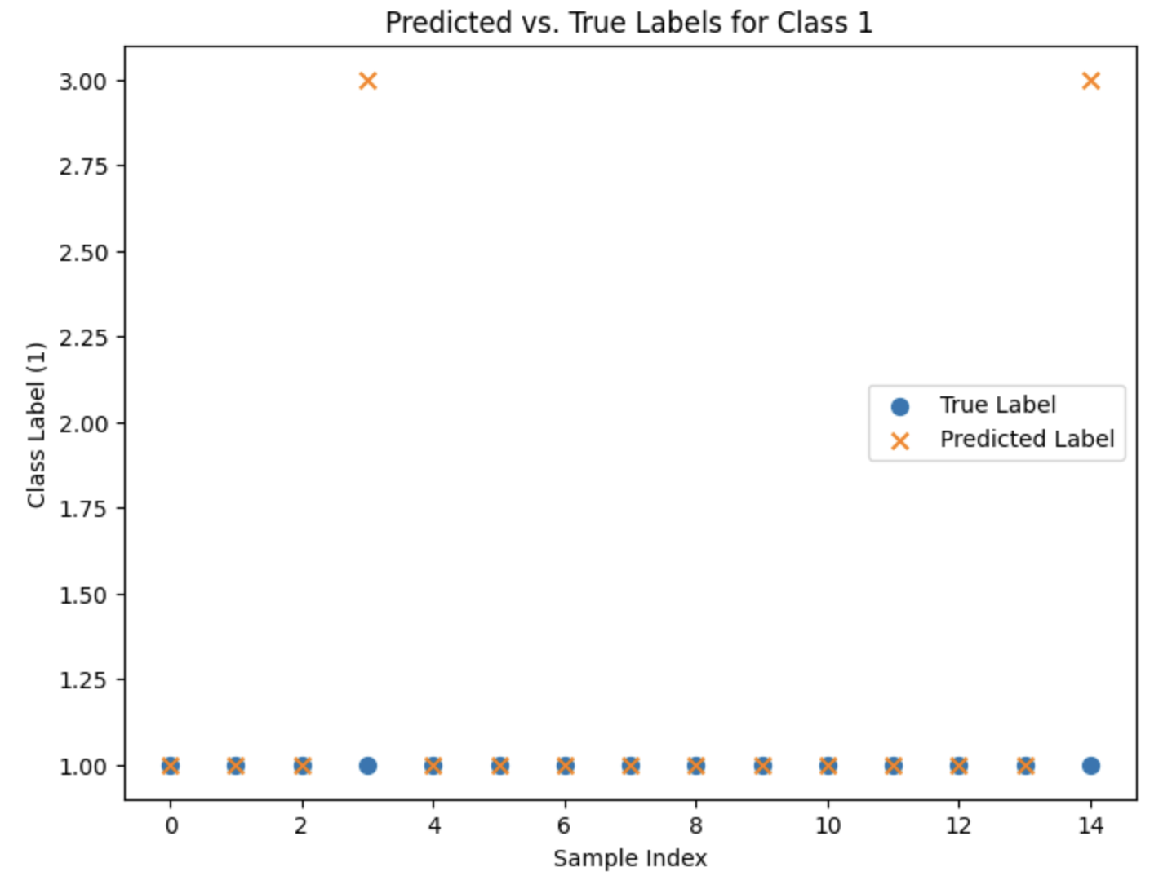
AND THE RESULTS ARE…
Predictions on 50 random Non-Demented validation samples
Predictions on Moderately Demented Validation Samples

Slide 17
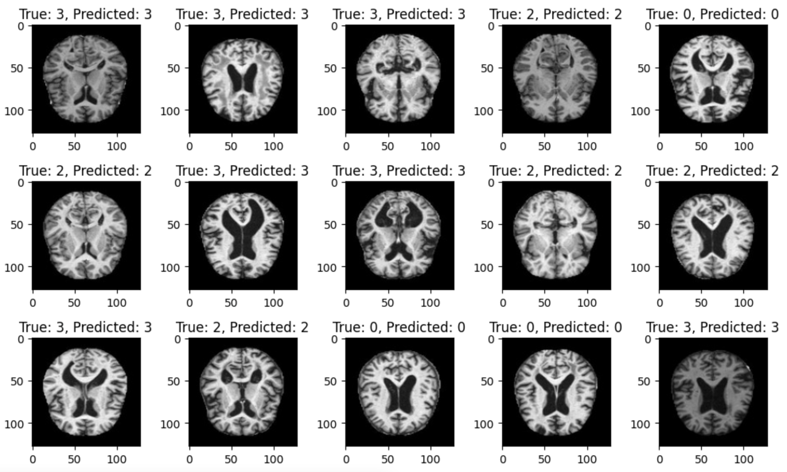
Model Predictions

